Slide 1
Modeling Linear Inequalities
Algebra I | Module 3 | Topic 1 | Lesson 3
Notes:
Note: Total suggested pacing for this lesson is three 45-minute sessions.

Slide 2
Objectives
Write and solve inequalities.
Analyze a graph on a coordinate plane to solve problems
involving inequalities.
Interpret how a negative rate affects how to solve
an inequality.
Notes:
TEKS:
A.1A: apply mathematics to problems arising in everyday life, society, and the workplace.
A.1D: communicate mathematical ideas, reasoning, and their implications using multiple representations, including symbols, diagrams, graphs, and language as appropriate.
A.1G: display, explain, and justify mathematical ideas and arguments using precise mathematical language in written or oral communication.
A.2C: write linear equations in two variables given a table of values, a graph, and a verbal description.
A.5B: solve linear inequalities in one variable, including those for which the application of the distributive property is necessary and for which variables are included on both sides.
ELPS:
2.C: learn new language structures, expressions, and basic and academic vocabulary heard during classroom instruction and interactions.
5.D: edit writing for standard grammar and usage, including subject-verb agreement, pronoun agreement, and appropriate verb tenses commensurate with grade-level expectations as more English is acquired.
5.E: employ increasingly complex grammatical structures in content area writing commensurate with grade level expectations such as (i) using correct verbs, tenses, and pronouns/antecedents; (ii) using possessive case (apostrophe -s) correctly; and, (iii) using negatives and contractions correctly.

Slide 3
Key Terms (1 of 2)
linear inequality [desigualdad lineal]: a linear inequality is a
non-equal comparison of two linear expressions
Example
  Diego has $25 in his gift fund that he is going to use to buy graduation gifts. Graduation is 9 weeks away. He would like to have at least $70 to buy gifts, how much should he save each week?
Notes:
Note: Linear inequality is introduced on Day 1.

Slide 4
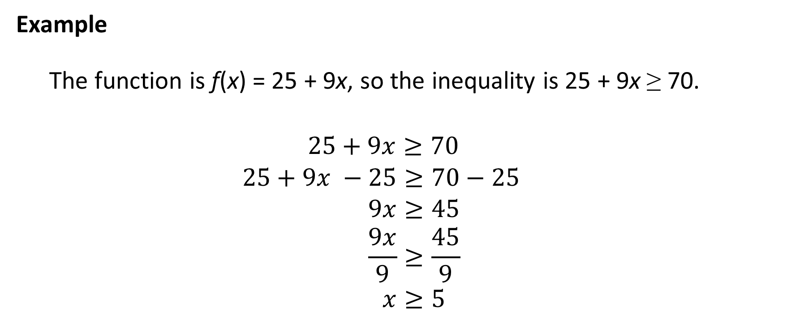
Key Terms (2 of 2)
Example
  The function is f(x) = 25 + 9x, so the inequality is 25 + 9x ≥ 70.
  $25+9x≥70$
  $$25+9x −25≥70−25 \\ 9x≥45 \\ \frac{9x}{9}≥\frac{45}{9} \\ x≥5$$
Notes:
Note: Linear inequality is introduced on Day 1.

Slide 5
Essential Question (1 of 3)
You have used horizontal lines on a graph and properties of equality with equations to solve problems that can be modeled with linear equations.
Can you use these same methods to solve problems involving linear inequalities?
Notes:
Setting the Stage:
Tap into your student’s prior learning by reading the narrative statement.
Provide a sense of direction by reading the Essential Question.

Slide 6
Day 1
1
Notes:
Note: Total suggested pacing for Day 1 is 45 minutes.

Slide 7
Getting Started
10–15
Notes:
Note: Total time of 10-15 minutes allotted for the Getting Started.

Slide 8
Fundraising Function (1 of 6)
Elijah’s camping troop is selling popcorn to earn money for an upcoming camping trip. Each camper starts with a credit of $25 toward his sales, and each box of popcorn sells for $3.75.
Ask Yourself…
How will you
represent the
$25 credit in
your function?
Notes:
Questions to Support Discourse – Gathering:
Explain the scenario in your own words.
Questions to Support Discourse – Seeing Structure:
Which type of function models this scenario? Why?

Slide 9
Fundraising Function (2 of 6)
Write a function, f(b), to show Elijah’s total sales as a function of the number of boxes of popcorn he sells, b.
Notes:
Questions to Support Discourse – Probing:
How are the key features of the function identifiable in the scenario given?
Questions to Support Discourse – Gathering:
How did you use function notation to represent the independent and dependent quantities?
What are the units for the slope?

Slide 10
Fundraising Function (3 of 6)
Analyze the function you wrote.
  Identify the independent and dependent quantities and their units.
  What is the slope of the function? What does it represent in this problem situation?
Notes:
Questions to Support Discourse – Probing:
How are the key features of the function identifiable in the scenario given?
Questions to Support Discourse – Gathering:
How did you use function notation to represent the independent and dependent quantities?
What are the units for the slope?

Slide 11
Fundraising Function (4 of 6)
What is the y-intercept? What does it represent in this problem situation?
Notes:
Questions to Support Discourse – Probing:
How are the key features of the function identifiable in the scenario given?
Questions to Support Discourse – Gathering:
How did you use function notation to represent the independent and dependent quantities?
What are the units for the slope?

Slide 12

Fundraising Function (5 of 6)
Let’s summarize our learning from the Getting Started!
Notes:
Getting Started Summary:
A scenario can be represented by a function that describes the rate of change and the y-intercept.

Slide 13
Fundraising Function (6 of 6)
Notes:
Note: This slide is blank for optional use with displaying work.

Slide 14
Activity 3.1
3.1
25–30
Notes:
Note: Total time of 25-30 minutes allotted for Activity 3.1.

Slide 15
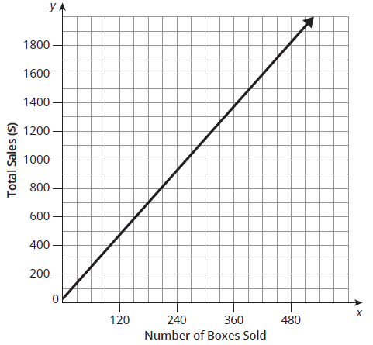

Modeling Linear Inequalities (1 of 14)
The graph shown represents the function you wrote in the previous activity, $f\left(b\right)=3.75b+25$.

Slide 16
Modeling Linear Inequalities (2 of 14)
Suppose Elijah has a sales goal of $1600.
  Draw a horizontal line from the y-axis until it intersects with the graphed function to determine the point on the graph that represents $1600 in total sales.
  How many boxes would Elijah have to sell to make $1600 in total sales? Explain your reasoning.
Ask Yourself…
Will the points
you graph on the number line be open or closed?
Notes:
Questions to Support Discourse – Probing:
Why does this situation require only Quadrant I of the coordinate plane?
How does the number line in part (c) relate to the graph?
Why doesn’t your inequality symbol include an equals sign?
Mark the described region on the graph.
What is the inequality in terms of the dependent variable?
How did you know what inequality symbol to use?
What is the inequality in terms of the independent variable?
Questions to Support Discourse – Seeing Structure:
How is your response on the number line related to the information on the coordinate plane?
Why do only positive integers make sense for this situation?

Slide 17

Modeling Linear Inequalities (3 of 14)
Use the number line to represent the number of boxes sold if the total sales is equal to $1600.
Notes:
Questions to Support Discourse – Probing:
Why does this situation require only Quadrant I of the coordinate plane?
How does the number line in part (c) relate to the graph?
Why doesn’t your inequality symbol include an equals sign?
Mark the described region on the graph.
What is the inequality in terms of the dependent variable?
How did you know what inequality symbol to use?
What is the inequality in terms of the independent variable?
Questions to Support Discourse – Seeing Structure:
How is your response on the number line related to the information on the coordinate plane?
Why do only positive integers make sense for this situation?

Slide 18
Modeling Linear Inequalities (4 of 14)
Analyze the region of the graph that lies below the horizontal line you drew, up to and including the point intersected by the line.
What does this region of the graph represent?
A linear inequality is a non-equal comparison of two linear expressions.
Notes:
Questions to Support Discourse – Probing:
Why does this situation require only Quadrant I of the coordinate plane?
How does the number line in part (c) relate to the graph?
Why doesn’t your inequality symbol include an equals sign?
Mark the described region on the graph.
What is the inequality in terms of the dependent variable?
How did you know what inequality symbol to use?
What is the inequality in terms of the independent variable?
Questions to Support Discourse – Seeing Structure:
How is your response on the number line related to the information on the coordinate plane?
Why do only positive integers make sense for this situation?

Slide 19

Modeling Linear Inequalities (5 of 14)
Remember…
There are five inequality signs, less than (<), greater than (>), less than or equal (≤), greater than or equal (≥) and not equal (≠). The solution set of an inequality is all the values that make the inequality statement true.
Write an inequality to represent this region.
Use the number line to represent the number of boxes that are solutions to the inequality you wrote.
Notes:
Questions to Support Discourse – Probing:
Why does this situation require only Quadrant I of the coordinate plane?
How does the number line in part (c) relate to the graph?
Why doesn’t your inequality symbol include an equals sign?
Mark the described region on the graph.
What is the inequality in terms of the dependent variable?
How did you know what inequality symbol to use?
What is the inequality in terms of the independent variable?
Questions to Support Discourse – Seeing Structure:
How is your response on the number line related to the information on the coordinate plane?
Why do only positive integers make sense for this situation?

Slide 20
Modeling Linear Inequalities (6 of 14)
Do all the solutions make sense in context of the problem? Explain your reasoning.
Notes:
Questions to Support Discourse – Probing:
Why does this situation require only Quadrant I of the coordinate plane?
How does the number line in part (c) relate to the graph?
Why doesn’t your inequality symbol include an equals sign?
Mark the described region on the graph.
What is the inequality in terms of the dependent variable?
How did you know what inequality symbol to use?
What is the inequality in terms of the independent variable?
Questions to Support Discourse – Seeing Structure:
How is your response on the number line related to the information on the coordinate plane?
Why do only positive integers make sense for this situation?

Slide 21
Modeling Linear Inequalities (7 of 14)
Analyze the region of the graph that lies above the horizontal line you drew, not including the point intersected by the line.
What does this region of the graph represent?
Write an inequality to represent this region.
Notes:
Questions to Support Discourse – Probing:
Why does this situation require only Quadrant I of the coordinate plane?
How does the number line in part (c) relate to the graph?
Why doesn’t your inequality symbol include an equals sign?
Mark the described region on the graph.
What is the inequality in terms of the dependent variable?
How did you know what inequality symbol to use?
What is the inequality in terms of the independent variable?
Questions to Support Discourse – Seeing Structure:
How is your response on the number line related to the information on the coordinate plane?
Why do only positive integers make sense for this situation?

Slide 22

Modeling Linear Inequalities (8 of 14)
Graphing the
solutions to
inequalities on
number lines will
prepare you for
graphing linear
inequalities in two
variables.
Use the number line to represent the number of boxes that are solutions to the inequality you wrote.
Notes:
Questions to Support Discourse – Probing:
Why does this situation require only Quadrant I of the coordinate plane?
How does the number line in part (c) relate to the graph?
Why doesn’t your inequality symbol include an equals sign?
Mark the described region on the graph.
What is the inequality in terms of the dependent variable?
How did you know what inequality symbol to use?
What is the inequality in terms of the independent variable?
Questions to Support Discourse – Seeing Structure:
How is your response on the number line related to the information on the coordinate plane?
Why do only positive integers make sense for this situation?

Slide 23
Modeling Linear Inequalities (9 of 14)
Do all the solutions make sense in context of the problem? Explain your reasoning.
Notes:
Questions to Support Discourse – Probing:
Why does this situation require only Quadrant I of the coordinate plane?
How does the number line in part (c) relate to the graph?
Why doesn’t your inequality symbol include an equals sign?
Mark the described region on the graph.
What is the inequality in terms of the dependent variable?
How did you know what inequality symbol to use?
What is the inequality in terms of the independent variable?
Questions to Support Discourse – Seeing Structure:
How is your response on the number line related to the information on the coordinate plane?
Why do only positive integers make sense for this situation?

Slide 24
Modeling Linear Inequalities (10 of 14)
Explain the difference between the open and closed circles on your number lines.
Ask Yourself…
How does determining the intersection point help you determine your answers?
Notes:
Questions to Support Discourse – Gathering:
Explain what the phrase at least means.
Questions to Support Discourse – Probing:
How did you modify the original function to write the inequality?
How can you identify the values of the independent variable that apply to this question?
Questions to Support Discourse – Seeing Structure:
How is part (c) different than parts (a) and (b)? How is this difference reflected in your response?

Slide 25
Modeling Linear Inequalities (11 of 14)
Use the graph to answer each question. Write an equation or inequality statement for each.
  How many boxes would Elijah have to sell to earn at least $925?
Notes:
Questions to Support Discourse – Gathering:
Explain what the phrase at least means.
Questions to Support Discourse – Probing:
How did you modify the original function to write the inequality?
How can you identify the values of the independent variable that apply to this question?
Questions to Support Discourse – Seeing Structure:
How is part (c) different than parts (a) and (b)? How is this difference reflected in your response?

Slide 26
Modeling Linear Inequalities (12 of 14)
How many boxes would Elijah have to sell to earn less
than $2050?
How many boxes would Elijah have to sell to earn exactly $700?
Notes:
Questions to Support Discourse – Gathering:
Explain what the phrase at least means.
Questions to Support Discourse – Probing:
How did you modify the original function to write the inequality?
How can you identify the values of the independent variable that apply to this question?
Questions to Support Discourse – Seeing Structure:
How is part (c) different than parts (a) and (b)? How is this difference reflected in your response?

Slide 27
Modeling Linear Inequalities (13 of 14)
Let’s revisit the Essential Question and summarize our learning from Activity 3.2!
Essential Question: Can you use these same methods to solve problems involving linear inequalities?
Notes:
Note: To close Day 1, have students reread the Essential Question and then read the Stamp the Learning summary aloud.
Activity 3.2 Summary:
Regions of a graphed function can be represented on a number line as solutions to an inequality.

Slide 28
Modeling Linear Inequalities (14 of 14)
Notes:
Note: This slide is blank for optional use with displaying work.

Slide 29
Day 2
2
Notes:
Note: Total suggested pacing for Day 2 is 45 minutes.

Slide 30
Essential Question (2 of 3)
Can you use these same methods to solve problems involving linear inequalities?
Notes:
Note: To begin Day 2, have a student read the Essential Question aloud.

Slide 31
Activity 3.2
3.2
15–20
Notes:
Note: Total time of 15-20 minutes allotted for Activity 3.2.

Slide 32
Solving Two-Step Linear Inequalities (1 of 8)
Another way to determine the solution set of any inequality is to solve it algebraically. The objective when solving an inequality is similar to the objective when solving an equation: You want to isolate the variable on one side of the inequality symbol.
To make the first deposit on the trip, Elijah’s total sales, f(b), need to be at least $1100.
To solve an inequality means to determine the values of the variable that make the inequality true.

Slide 33

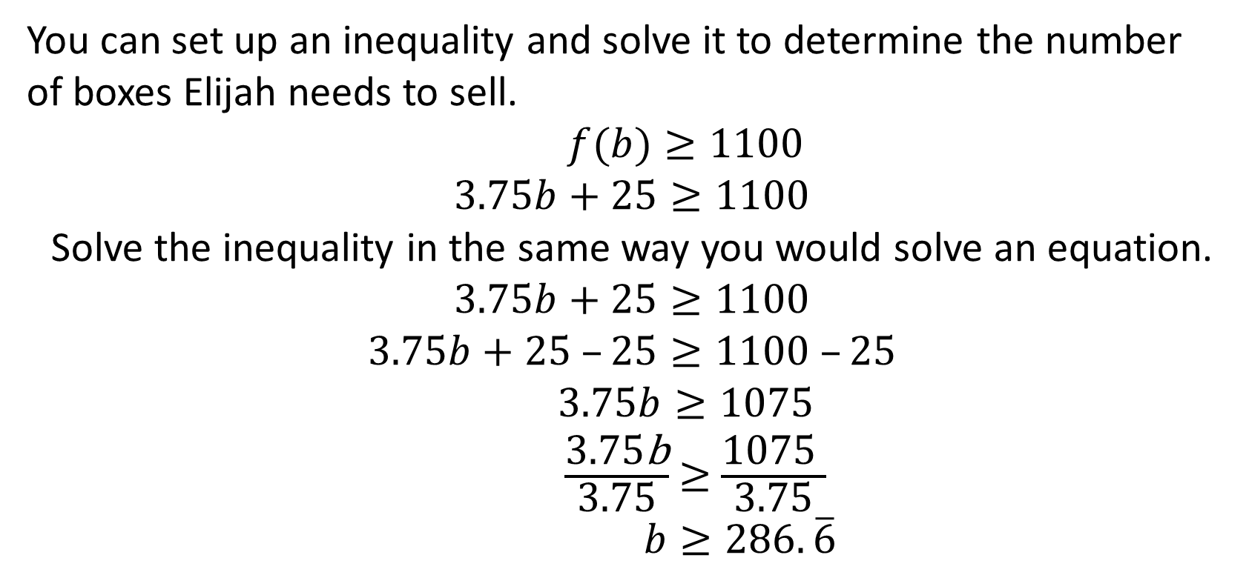
Solving Two-Step Linear Inequalities (2 of 8)
You can set up an inequality and solve it to determine the number
of boxes Elijah needs to sell.
$f(b)≥1100$
$$3.75b+25≥1100$$
Solve the inequality in the same way you would solve an equation.
$$3.75b+25≥1100$$
$$3.75b+25 –25≥1100 –25$$
$3.75b≥1075$
$\frac{\text{3.75}\text{b}}{\text{3.75}}$ $≥$ $\frac{\text{1075} }{\text{3.75}}$
$b≥286.\overline{6}$

Slide 34
Solving Two-Step Linear Inequalities (3 of 8)
Think about…
How accurate does your answer need to be?
How many boxes of popcorn does Elijah need to sell to make the first deposit? Explain your reasoning.
Notes:
Questions to Support Discourse – Probing:
Explain how the inequality makes sense for the situation in the Worked Example.
Since the situation involves whole boxes of popcorn only, how did you know whether the solution is b ≥ 286 or b ≥ 287?
Questions to Support Discourse – Seeing Structure:
What is the relationship between the steps to solve an inequality and the steps to solve an equation?

Slide 35
Solving Two-Step Linear Inequalities (4 of 8)
Write and solve an inequality for each. Show your work.
  What is the greatest number of boxes Elijah could sell and still not have made $600 in sales?
Notes:
Questions to Support Discourse – Probing:
How did you know what inequality symbol to use for this situation?
How did you solve the inequality?
How do you know whether to round up or down to the nearest integer?
Questions to Support Discourse – Seeing Structure:
Consider the inequality 3.75b + 25 ≥ 1500. How would you rewrite this inequality if you wanted 1500 to be on the left side of the inequality?

Slide 36
Solving Two-Step Linear Inequalities (5 of 8)
At least how many boxes would Elijah have to sell to make $1500 in sales?
Notes:
Questions to Support Discourse – Probing:
How did you know what inequality symbol to use for this situation?
How did you solve the inequality?
How do you know whether to round up or down to the nearest integer?
Questions to Support Discourse – Seeing Structure:
Consider the inequality 3.75b + 25 ≥ 1500. How would you rewrite this inequality if you wanted 1500 to be on the left side of the inequality?

Slide 37
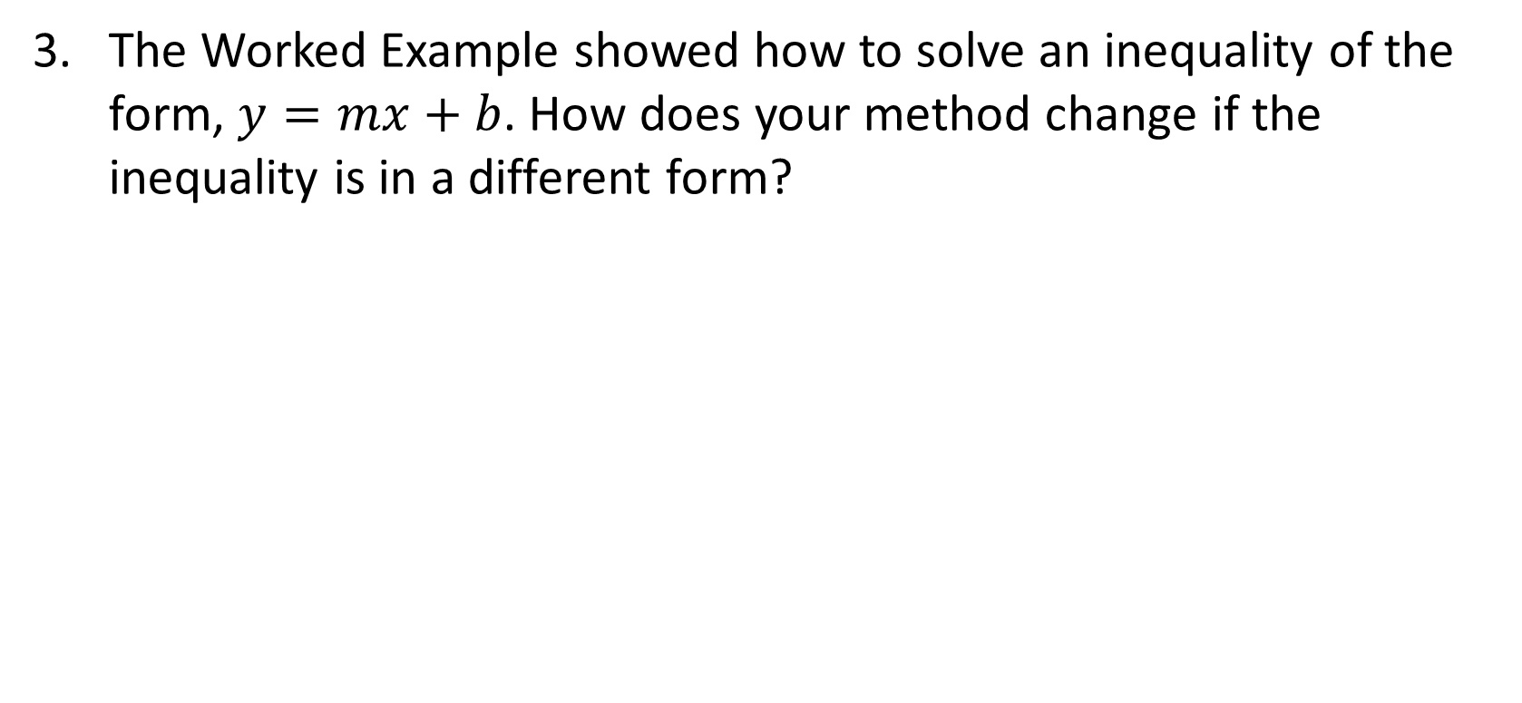
Solving Two-Step Linear Inequalities (6 of 8)
The Worked Example showed how to solve an inequality of the form, $y=mx+b$. How does your method change if the inequality is in a different form?
Notes:
Questions to Support Discourse – Probing:
How did you know what inequality symbol to use for this situation?
How did you solve the inequality?
How do you know whether to round up or down to the nearest integer?
Questions to Support Discourse – Seeing Structure:
Consider the inequality 3.75b + 25 ≥ 1500. How would you rewrite this inequality if you wanted 1500 to be on the left side of the inequality?

Slide 38
Solving Two-Step Linear Inequalities (7 of 8)
Let’s summarize our learning from Activity 3.2!
Notes:
Activity 3.2 Summary:
Problems in context can be represented and solved using inequalities. Solving an inequality is similar to solving an equation; both involve using properties of equality and number properties.

Slide 39
Solving Two-Step Linear Inequalities (8 of 8)
Notes:
Note: This slide is blank for optional use with displaying work.

Slide 40
Activity 3.3
3.3
20–25
Notes:
Note: Total time of 20-25 minutes allotted for Activity 3.3.

Slide 41
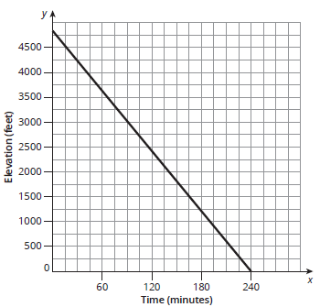
Reversing Inequality Signs (1 of 9)
Sea level has an elevation of 0 feet.
Elijah’s camping troop hikes down from their campsite at an elevation of 4800 feet to the base of the mountain, which is at sea level. They hike down at a rate of 20 feet per minute.
Write a function, h(m), to show the troop’s elevation as a function of time in minutes. Label the function on the coordinate plane.
Notes:
Questions to Support Discourse – Seeing Structure:
Which type of function models this scenario? Why?
Why might someone prefer to write the function as h(m) = 4800 – 20m rather than h(m) = –20m + 4800?
Questions to Support Discourse – Probing:
Why is the coefficient of the variable a negative number?
How can you determine the x-intercept from the equation?
Explain how you identified the domain.

Slide 42
Reversing Inequality Signs (2 of 9)
Analyze the function. Identify each characteristic and explain what it means in terms of this problem situation.
  Slope
  y-intercept
Ask Yourself…
What are the
independent
and dependent
quantities and
their units?
Notes:
Questions to Support Discourse – Seeing Structure:
Which type of function models this scenario? Why?
Why might someone prefer to write the function as h(m) = 4800 – 20m rather than h(m) = –20m + 4800?
Questions to Support Discourse – Probing:
Why is the coefficient of the variable a negative number?
How can you determine the x-intercept from the equation?
Explain how you identified the domain.

Slide 43
Reversing Inequality Signs (3 of 9)
x-intercept
Domain of the function
Notes:
Questions to Support Discourse – Seeing Structure:
Which type of function models this scenario? Why?
Why might someone prefer to write the function as h(m) = 4800 – 20m rather than h(m) = –20m + 4800?
Questions to Support Discourse – Probing:
Why is the coefficient of the variable a negative number?
How can you determine the x-intercept from the equation?
Explain how you identified the domain.

Slide 44
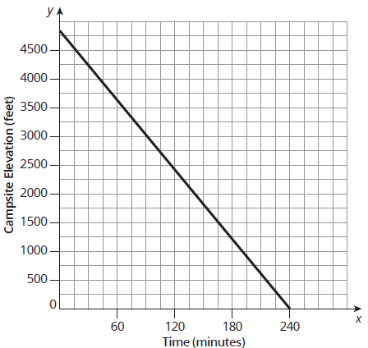
Reversing Inequality Signs (4 of 9)
Use the graph to determine how many minutes passed if the troop is below 3200 feet. Draw an oval on the graph to represent this part of the function and write the corresponding inequality statement.
Notes:
Questions to Support Discourse – Probing:
How did you use the graph to determine the smallest independent value that makes sense in this situation?
Explain your steps to solve the inequality.
Are your algebraic and graphical solutions the same? Explain.

Slide 45
Reversing Inequality Signs (5 of 9)
Write and solve an inequality to verify the solution set you interpreted from the graph.
Compare and contrast the solution sets you wrote using the graph and the function. What do you notice?
Notes:
Questions to Support Discourse – Probing:
How did you use the graph to determine the smallest independent value that makes sense in this situation?
Explain your steps to solve the inequality.
Are your algebraic and graphical solutions the same? Explain.

Slide 46
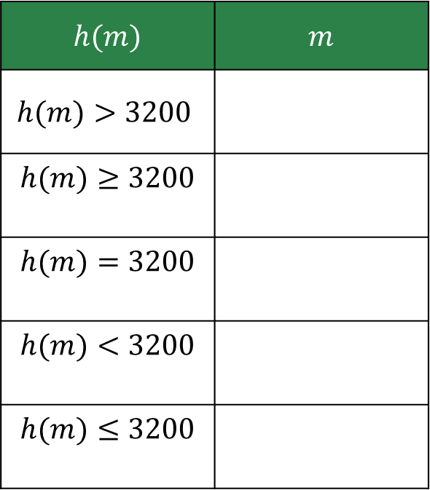
Reversing Inequality Signs (6 of 9)
Analyze the relationship between the inequality statements representing h(m) and m.
  Complete the table by writing the corresponding inequality statement
  that represents the number of minutes for each height.
$h(m)$ | $m$
$$h(m)>3200$$
$$h(m)≥3200$$
$$h(m)=3200$$
$$h(m)<3200$$
$$h(m)≤3200$$
Notes:
Questions to Support Discourse – Seeing Structure:
Why do you think you reverse the inequality symbols in this scenario but not in Elijah’s popcorn sales scenario? What is different about the scenarios?
How do you know when to reverse the inequality symbol and when to keep it as is?

Slide 47
Reversing Inequality Signs (7 of 9)
Compare each row in the table shown. What do you notice about the inequality signs?
Explain your answer from part (b). Use what you know about solving inequalities when you have to multiply or divide by a negative number.
Notes:
Questions to Support Discourse – Seeing Structure:
Why do you think you reverse the inequality symbols in this scenario but not in Elijah’s popcorn sales scenario? What is different about the scenarios?
How do you know when to reverse the inequality symbol and when to keep it as is?

Slide 48
Reversing Inequality Signs (8 of 9)
Let’s revisit the Essential Question and summarize our learning from Activity 3.3!
Essential Question: Can you use these same methods to solve problems involving linear inequalities?
Notes:
Note: To close Day 2, have students reread the Essential Question and then read the Stamp the Learning summary aloud.
Activity 3.3 Summary:
When both sides of an inequality are multiplied or divided by a negative number, the sign of the resulting inequality is reversed.

Slide 49
Reversing Inequality Signs (9 of 9)
Notes:
Note: This slide is blank for optional use with displaying work.

Slide 50
Day 3
3
Notes:
Note: Total suggested pacing for Day 3 is 45 minutes.

Slide 51
Essential Question (3 of 3)
Can you use these same methods to solve problems involving linear inequalities?
Notes:
Note: To begin Day 3, have a student read the Essential Question aloud.

Slide 52
Activity 3.4
3.4
25–30
Notes:
Note: Total time of 25-30 minutes allotted for Activity 3.4.

Slide 53
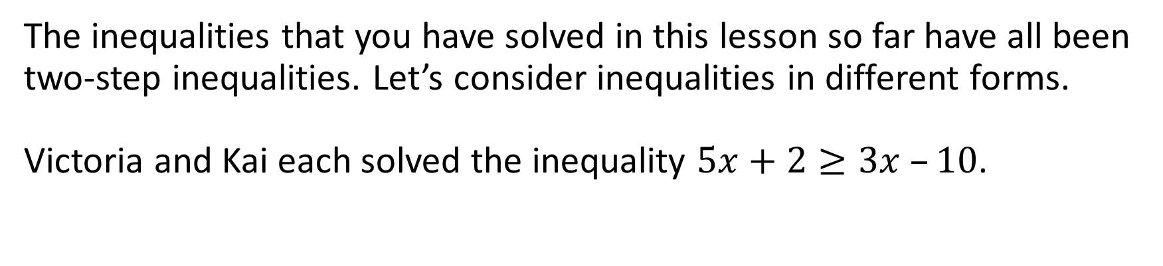
Solving Other Linear Inequalities (1 of 9)
The inequalities that you have solved in this lesson so far have all been two-step inequalities. Let’s consider inequalities in different forms.
Victoria and Kai each solved the inequality $5x+2≥3x –10$.

Slide 54
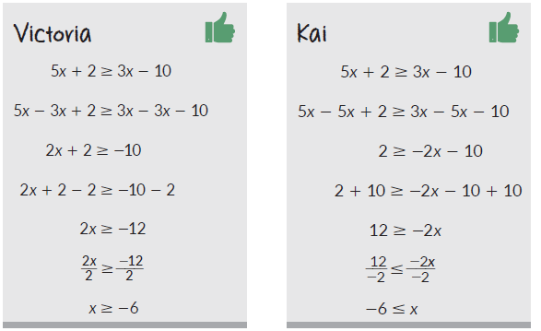
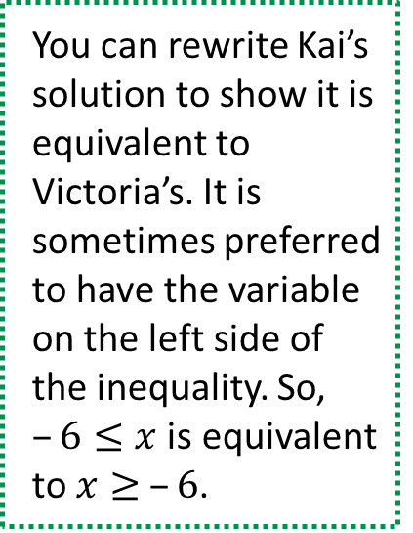
Solving Other Linear Inequalities (2 of 9)
You can rewrite Kai’s solution to show it is equivalent to Victoria’s. It is sometimes preferred to have the variable on the left side of the inequality. So, $–6≤x$ is equivalent to $x≥ –6$.

Slide 55
Solving Other Linear Inequalities (3 of 9)
Remember…
When multiplying or dividing by a negative number while solving inequalities, the inequality sign reverses.
Describe the process each student used to solve the inequality.
  Victoria b. Kai
Notes:
Questions to Support Discourse – Gathering:
Whose process do you prefer? Why?
Questions to Support Discourse – Probing:
How are Victoria’s and Kai’s processes the same? Different?
Questions to Support Discourse – Seeing Structure:
Why do you think the rule about reversing the signs applies to both division and multiplication?

Slide 56
Solving Other Linear Inequalities (4 of 9)
How does the process of solving an inequality with variables on both sides compare to the process of solving an equation with variables on both sides?
Notes:
Questions to Support Discourse – Gathering:
Whose process do you prefer? Why?
Questions to Support Discourse – Probing:
How are Victoria’s and Kai’s processes the same? Different?
Questions to Support Discourse – Seeing Structure:
Why do you think the rule about reversing the signs applies to both division and multiplication?

Slide 57
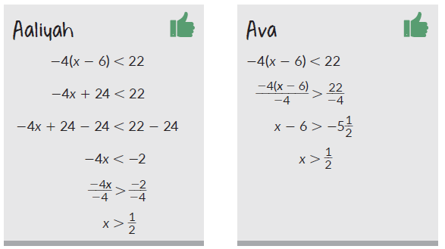
Solving Other Linear Inequalities (5 of 9)
Aaliyah and Ava each solved the inequality –4(x – 6) < 2.

Slide 58
Solving Other Linear Inequalities (6 of 9)
Describe the process each student used to solve the inequality.
  Aaliyah b. Ava
Notes:
Questions to Support Discourse – Probing:
Why did Ava reverse the inequality symbol earlier in her process?
Questions to Support Discourse – Seeing Structure:
Why didn’t Aaliyah reverse the inequality symbol when she used the distributive property to multiply by a negative number?

Slide 59
Solving Other Linear Inequalities (7 of 9)
How does the process of solving an inequality using the distributive property compare to the process of solving an equation using the distributive property?
Notes:
Questions to Support Discourse – Probing:
Why did Ava reverse the inequality symbol earlier in her process?
Questions to Support Discourse – Seeing Structure:
Why didn’t Aaliyah reverse the inequality symbol when she used the distributive property to multiply by a negative number?

Slide 60
Solving Other Linear Inequalities (8 of 9)
Let’s summarize our learning from Activity 3.4!
Notes:
Activity 3.4 Summary:
There are multiple solution paths when solving more complex linear inequalities. All correct solution paths involve the same steps as solving a linear equation as well as reversing the sign of the inequality symbol when both sides of the inequality are multiplied or divided by a negative number.

Slide 61
Solving Other Linear Inequalities (9 of 9)
Notes:
Note: This slide is blank for optional use with displaying work.

Slide 62
Talk the Talk
10–15
Notes:
Note: Total time of 10-15 minutes allotted for the Talk the Talk.

Slide 63
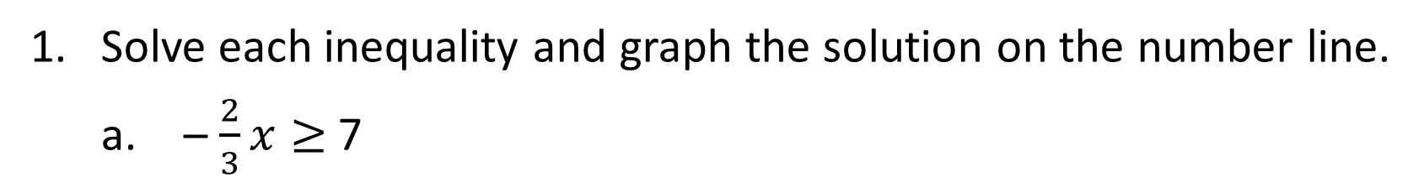
It’s About Solutions, More or Less (1 of 5)
Solve each inequality and graph the solution on the number line.
  – $\frac{2}{3}x≥$7
$32>23 – x$
Notes:
Questions to Support Discourse – Probing:
Did you rewrite the inequality in Question 2 before you solved it so that the variable was on the left side of the inequality symbol? If so, explain your process.
If you didn’t write the inequality in Question 2, explain how you graphed the solution – 9 < x.
For what inequalities did you have to apply the rule to reverse the inequality symbol?
Questions to Support Discourse – Seeing Structure:
For 5b, why is the equation true only for specific values of C?
How did you apply the rules to solve inequalities to complete these statements?

Slide 64
It’s About Solutions, More or Less (2 of 5)
$15 –4x ≤3x$ – 6
$2(x+6)<14+4x$
Notes:
Questions to Support Discourse – Probing:
Did you rewrite the inequality in Question 2 before you solved it so that the variable was on the left side of the inequality symbol? If so, explain your process.
If you didn’t write the inequality in Question 2, explain how you graphed the solution – 9 < x.
For what inequalities did you have to apply the rule to reverse the inequality symbol?
Questions to Support Discourse – Seeing Structure:
For 5b, why is the equation true only for specific values of C?
How did you apply the rules to solve inequalities to complete these statements?

Slide 65
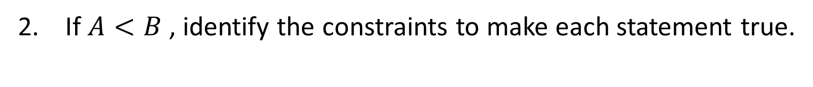
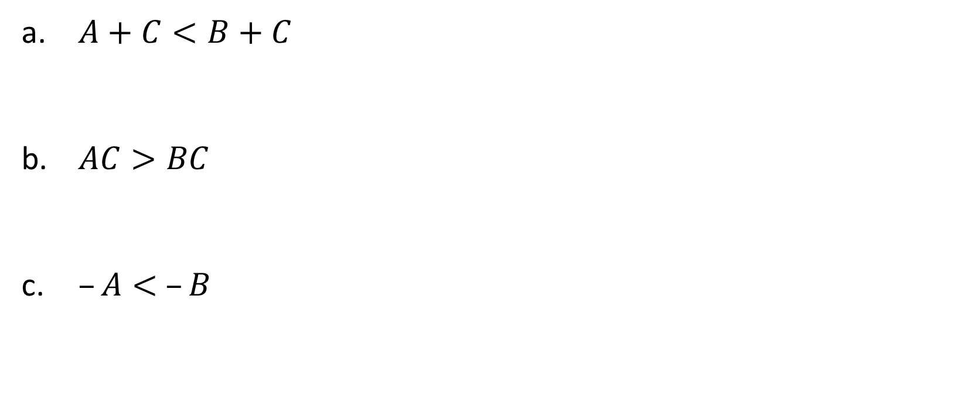
It’s About Solutions, More or Less (3 of 5)
If $A<B$ , identify the constraints to make each statement true.
$A+C<B+C$
$AC>BC$
$–A< –B$
Notes:
Questions to Support Discourse – Probing:
Did you rewrite the inequality in Question 2 before you solved it so that the variable was on the left side of the inequality symbol? If so, explain your process.
If you didn’t write the inequality in Question 2, explain how you graphed the solution – 9 < x.
For what inequalities did you have to apply the rule to reverse the inequality symbol?
Questions to Support Discourse – Seeing Structure:
For 5b, why is the equation true only for specific values of C?
How did you apply the rules to solve inequalities to complete these statements?

Slide 66
It’s About Solutions, More or Less (4 of 5)
Let’s answer the Essential Question and summarize our learning from the Talk the Talk!
Essential Question: Can you use these same methods to solve problems involving linear inequalities?
Notes:
Note: To close Day 3, have students read and answer the Essential Question and then read the Stamp the Learning summary aloud.
Essential Question:
Sample answer: I can use the same methods as long as I reverse the direction of the inequality symbol when multiplying or dividing both sides by a negative number.
Talk the Talk Summary:
There are multiple solution paths when solving more complex linear inequalities. All correct solution paths involve the same steps as solving a linear equation as well as reversing the sign of the inequality symbol when both sides of the inequality are multiplied or divided by a negative number.

Slide 67
It’s About Solutions, More or Less (5 of 5)
Notes:
Note: This slide is blank for optional use with displaying work.

Slide 68
Prepare
Notes:
How can you identify whether students are ready for new learning? ​
Depending on available time, you can assign the Prepare section of the Lesson Assignments as homework or as a warm-up to identify students' prior knowledge for the upcoming lesson's activities.

Slide 69
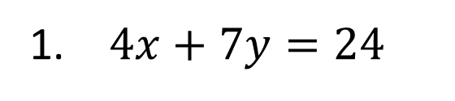


Prepare for Module 3 Topic 2 Lesson 1
Determine an ordered pair that represents a solution to each equation.
$4x+7y=24$
$5x –2y= –6$
$\frac{1}{2}x+\frac{3}{4}y=10$

Slide 70
Acknowledgment and Notice

Slide 71
BLMathematics_AlgI_M3_T1_L3_LessonSlides_ENG_2025

